Slide 1
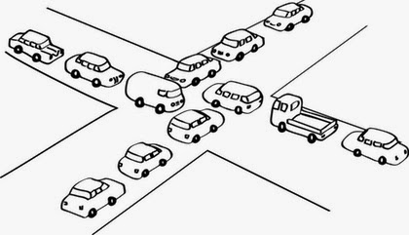
Deadlock
Concurrent Programming CT074-3-2 Version 0418

Slide 2
Topic & Structure of The Lesson
Deadlock

Slide 3
Learning Outcomes
At the end of this module, you should be able to do the following:
Identify necessary and sufficient conditions for deadlock.
Identify strategies for dealing with deadlock
Tracing blocked threads in Java

Slide 4
Key Terms You Must Be Able To Use
If you have mastered this topic, you should be able to use the following terms correctly in your assignments and exams:
Deadlock

Slide 5
Deadlock
Concepts: system deadlock: no further progress
four necessary & sufficient conditions
Models: deadlock - no eligible actions
Practice: blocked threads
Aim: deadlock avoidance - to design systems where deadlock cannot occur.

Slide 6
Starvation-freedom
Whatever the process p, each invocation of acquire_mutex() issued by p eventually terminates.
See barber waiting example

Slide 7
Deadlock-freedom
Whatever the time τ , if before τ one or several processes have invoked the operation acquire_mutex() and none of them has terminated its invocation at time τ , then there is a time τ’ > τ at which a process that has invoked acquire_mutex() terminates its invocation.

Slide 8
Deadlock: four necessary and sufficient conditions
Serially reusable resources:
the processes involved share resources which they use under mutual exclusion.
Incremental acquisition:
processes hold on to resources already allocated to them while waiting to acquire additional resources.

Slide 9
Deadlock: four necessary and sufficient conditions
No pre-emption:
once acquired by a process, resources cannot be pre-empted (forcibly withdrawn) but are only released voluntarily.
Wait-for cycle:
a circular chain (or cycle) of processes exists such that each process holds a resource which its successor in the cycle is waiting to acquire.

Slide 10
Wait-for cycle
Has A awaits B
A
Has E awaits A
E
B
Has B awaits C
D
C
Has C awaits D
Has D awaits E

Slide 11
In Class Discussion
Discuss if the following could exhibit one or more conditions for deadlock:
Ornamental Garden
Cark Park
Ornamental Garden
1 – counter
Cark Park
1 – parking bay
3 – no preemption
Notes:
Serially reusable resource – the counter
Serially reusable resource - spaces

Slide 12
Deadlock analysis – Case Study (Printer-Scanner Problem)
Case Study:
Two processes, P and Q, perform the same task, that of scanning a document and printing it by using a shared printer and shared scanner. Each process acquires both the printer and the scanner, performs the scanning and printing and then releases the scanner and printer resources.

Slide 13
Deadlock analysis – Case Study
P acquires the printer first and Q acquires the scanner first. The system satisfies the four necessary conditions for deadlock.
Serially reusable resources
Incremental acquisition
No preemption
Wait-for cycle
Why?

Slide 14
Dining Philosophers Problem
Five philosophers sit around a circular table. Each philosopher spends his life alternately thinking and eating. In the centre of the table is a large bowl of spaghetti. A philosopher needs two forks to eat a helping of spaghetti.
3
2
2
3
1
4
1
4
0
One fork is placed between each
pair of philosophers and they agree that each will only use the fork to his immediate right and left.
0
http://wwwhomes.doc.ic.ac.uk/~jnm/book/book_applets/concurrency.html

Slide 15
The Dining Philosophers system can now be described by the composition of five fork processes and five philosopher processes

Slide 16
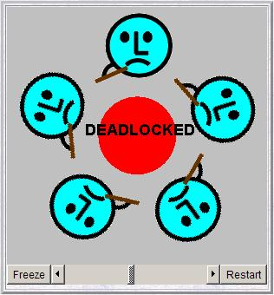
Dining Philosophers - model analysis
This is the situation where all the philosophers become hungry at the same time, sit down at the table and each philosopher picks up the fork to his right.
The system can make no further progress since each philosopher is waiting for a fork held by his neighbor i.e. a wait-for cycle exists!

Slide 17
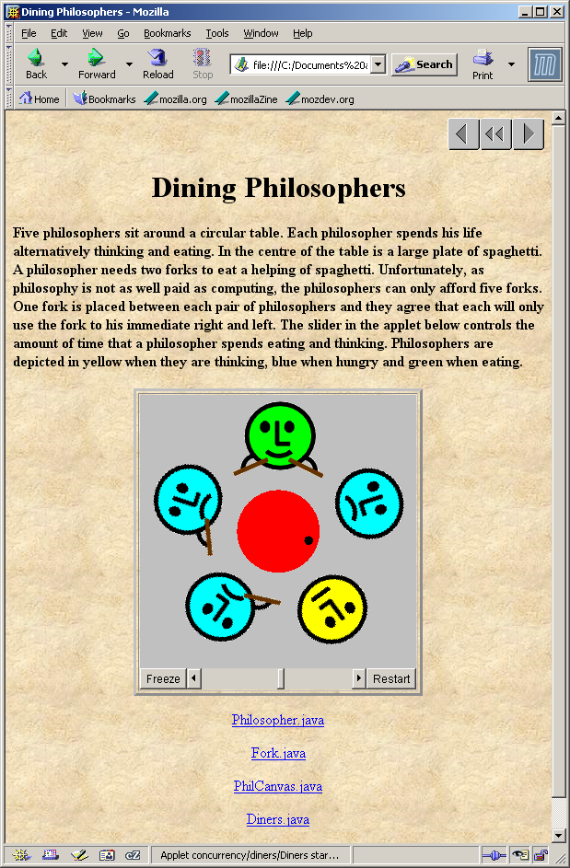
Dining Philosophers
Deadlock is easily detected in our model.
How easy is it to detect a potential deadlock in an implementation – i.e. in your CCP assignment?

Slide 18
Dining Philosophers - implementation in Java
While deadlock can be easily detected in a model, it is not so apparent in the running program which corresponds to that model.
In translating the Dining Philosophers model into an implementation, we must consider which processes in the model will be represented by passive objects (monitors) and which by active objects (threads).
Forks are the passive entities and philosophers are the active entities in the system.

Slide 19
Dining Philosophers - implementation in Java
philosophers: active entities - implement as threads
forks: shared passive entities - implement as monitors
display

Slide 20
Dining Philosophers - Fork monitor
class Fork {
private boolean taken=false;
private PhilCanvas display;
private int identity;
Fork(PhilCanvas disp, int id)
{ display = disp; identity = id;}
synchronized void put() {
taken=false;
display.setFork(identity,taken);
notify();
}
synchronized void get()
throws java.lang.InterruptedException {
while (taken) wait();
taken=true;
display.setFork(identity,taken);
}
}
taken encodes the state of the fork

Slide 21
Dining Philosophers - Philosopher implementation
class Philosopher extends Thread {
...
public void run() {
try {
while (true) { // thinking
view.setPhil(identity,view.THINKING);
sleep(controller.sleepTime()); // hungry
view.setPhil(identity,view.HUNGRY);
right.get(); // gotright chopstick
view.setPhil(identity,view.GOTRIGHT);
sleep(500);
left.get(); // eating
view.setPhil(identity,view.EATING);
sleep(controller.eatTime());
right.put();
left.put();
}
} catch (java.lang.InterruptedException e){}
}
}
Follows from the model (sitting down and leaving the table have been omitted).

Slide 22
Dining Philosophers - implementation in Java
Code to create the philosopher threads and fork monitors:
for (int i =0; i<N; ++i)
fork[i] = new Fork(display,i);
for (int i =0; i<N; ++i){
phil[i] =
new Philosopher
(this,i,fork[(i-1+N)%N],fork[i]);
phil[i].start();
}

Slide 23
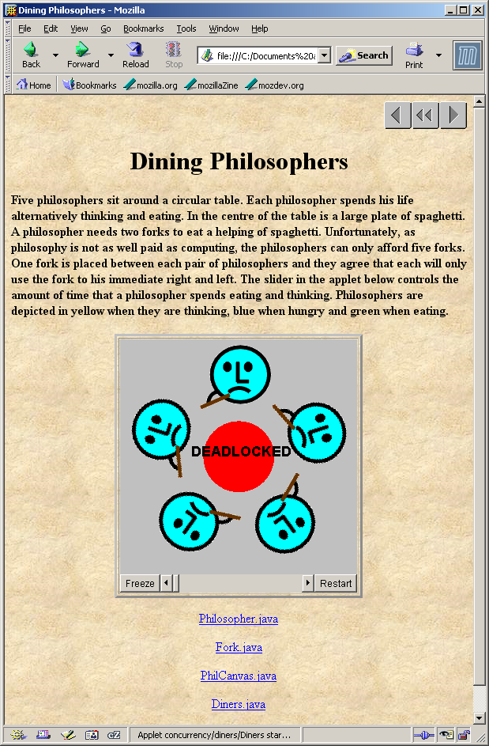
Dining Philosophers
To ensure deadlock occurs eventually, the slider control may be moved to the left. This reduces the time each philosopher spends thinking and eating.
This "speedup" increases the probability of deadlock occurring.

Slide 24
Deadlock-free Philosophers
Deadlock can be avoided by ensuring that a wait-for cycle cannot exist. How?
Introduce an asymmetry into our definition of philosophers.
Use the identity I of a philosopher to make even numbered philosophers get their left forks first, odd their right first.
Other strategies?
Notes:
When a philosopher wants to eat, he/she checks both chopsticks. If they are free, then he/she eats. Otherwise, he/she waits on a condition variable. Whenever a philosopher finishes eating, he/she checks to see if his neighbors want to eat and are waiting. If so, then he/she calls signal on their condition variables so that they can recheck the chopsticks and eat if possible.

Slide 25
Resume at 3:45 p.m.

Slide 26
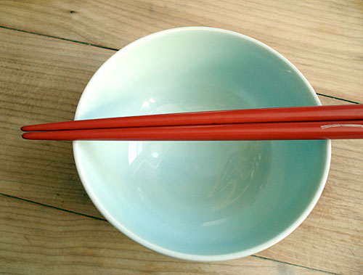
Other strategies
When a philosopher wants to eat, he/she checks both chopsticks. If they are free, then he/she eats. Otherwise, he/she waits on a condition variable.

Slide 27
Other strategies
Whenever a philosopher finishes eating, he/she checks to see if his neighbors want to eat and are waiting. If so, then he/she calls signal on their condition variables so that they can recheck the chopsticks and eat if possible.
And many more…..

Slide 28
Summary
Concepts
deadlock: no further progress
four necessary and sufficient conditions:
serially reusable resources
incremental acquisition
no pre-emption
wait-for cycle
Practice
blocked threads

Slide 29
Do it yourself!
Download the Dining Philosophers problem and scrutinize the solution given.
You should understand the following:
The problem – from a programming point of view
The solution – from a programming point of view
Solution 1:
Use the identity I of a philosopher to make even numbered philosophers get their left fork first, odd their right first.
Solution 2: To be shown in the Lab session
Propose and implement another solution for this problem.

Slide 30
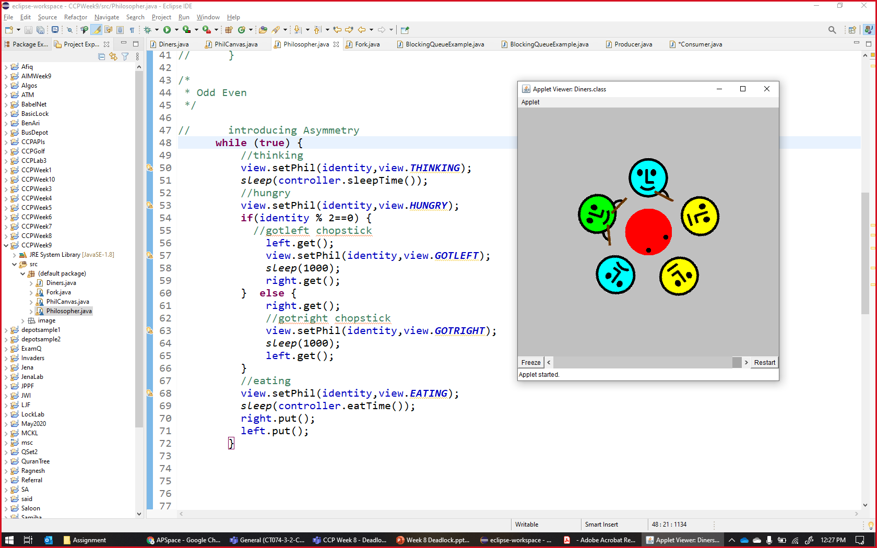
Assignment Part 1
Due Friday 1st October 2021

Slide 31
References
Jeff M & Jeff K, Concurrency – State Models & Java Programming

Slide 32
Q & A

Slide 33
What we will cover next
Safety

Slide 34
Lab
Semaphore API
MS Forms answers

Slide 35
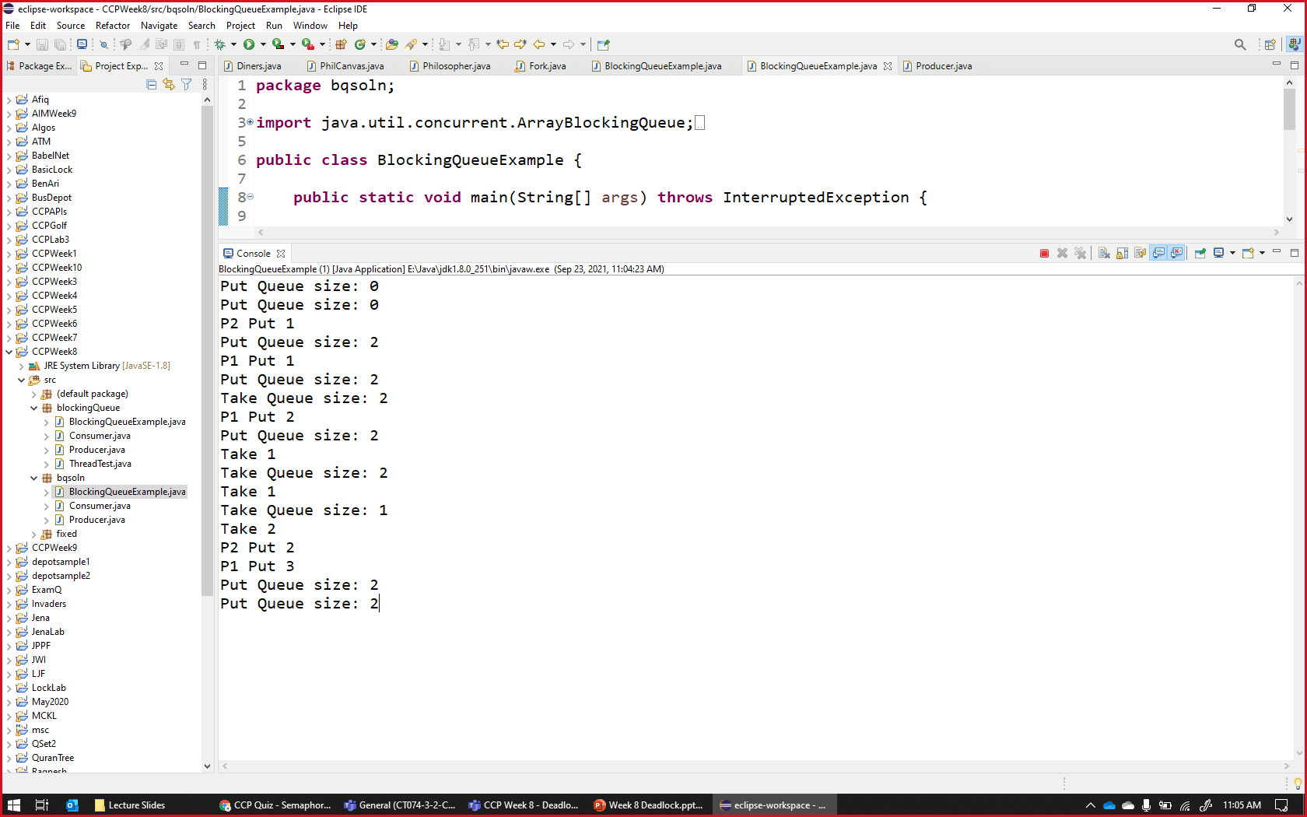

Slide 36
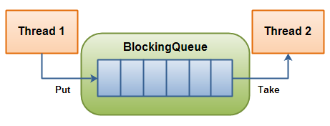
BlockingQueue
A BlockingQueue is typically used to have one thread produce objects, which another thread consumes.
This blockingqueue has 6 spaces.

Slide 37
Lab
Prepare Java IDE
NetBeans
Eclipse
Etc.

